Slide 1
COLT 2024 — OPEN PROBLEM
Can Local Regularization
Learn All Multiclass Problems?
Asilis • Devic • Dughmi • Sharan • Teng | University of Southern California
Paper Presentation
Project Implementation
Proceedings of Machine Learning Research, Vol. 196, 2024

Slide 2
Presentation Outline
01
Motivation
Binary vs multiclass, why ERM fails
02
Related Work
OIGs, DS dimension, and existing learners
03
Theoretical Formulas
PAC learning, local regularization, H-triangle — every formula explained
04
Experimental Results
ERM failure, local regularizer analysis, scaling
05
Conclusion & Open Problems
What remains to be resolved

Slide 3
01 MOTIVATION
Binary vs. Multiclass Classification
Binary |Y| = 2
Multiclass |Y| >= 2
VC dimension characterizes learnability
ERM is optimal and sufficient
Well-understood since the 1980s
Characterized only in 2022 (DS dimension)
ERM fails — improper learning required
No simple optimal learning rule known
Can we find a simple algorithmic template for multiclass — like ERM for binary?

Slide 4
03 THEORETICAL FORMULAS
The 0-1 Loss and True Risk
Classification Loss & Risk
L_D(h) = E_{(x,y)~D} [ l_{0-1}( h(x), y ) ]
l_{0-1}(y_hat, y) = 0 if y_hat = y, else 1 — the 0-1 loss: wrong prediction costs 1, correct costs 0
D is a distribution over (x, y) pairs — the true data-generating process, unknown to the learner
h : X -> Y is a hypothesis — a function that maps inputs to labels
L_D(h) is the true risk — the expected error of h under the real distribution D
Goal of learning: find h with L_D(h) <= epsilon, i.e., true error at most epsilon

Slide 5
03 THEORETICAL FORMULAS
Empirical Risk & ERM
Empirical Risk Minimization
ERM: output any h in argmin_{h in H} L_S(h)
where L_S(h) = (1/n) SUM_i l_{0-1}( h(x_i), y_i )
S = {(x_1,y_1), ..., (x_n,y_n)} is the training sample drawn i.i.d. from D
L_S(h) is the empirical risk — the fraction of training points h gets wrong
ERM picks any h from H with minimum (ideally zero) training error
For binary classification: ERM is optimal — achieves near-best sample complexity
For multiclass: ERM is PROPER (outputs only h in H) — proven insufficient by Daniely & Shalev-Shwartz (2014)

Slide 6
03 THEORETICAL FORMULAS
PAC Learning (Definition 1)
Definition 1: PAC Learner
For all realizable D, for all eps, delta in (0,1):
P[ L_D(A(S)) <= eps ] >= 1 - delta
when |S| >= m(eps, delta)
A is a PAC learner for H if it can learn to low error with high probability
eps (epsilon) = error tolerance — how much error we allow
delta = failure probability — how often the learner is allowed to fail
m(eps, delta) = sample complexity — how many training points are needed
Realizable: there exists h* in H with L_D(h*) = 0 — perfect hypothesis exists
m_H(eps, delta) = min over all learners A of m_A(eps, delta) — optimal sample complexity of H

Slide 7
03 THEORETICAL FORMULAS
Structural Risk Minimization (SRM)
SRM Learner
SRM: output argmin_{h in H} L_S(h) + psi(h)
where psi : H -> R_{>=0}
psi(h) is a global regularizer — assigns a fixed complexity score to each hypothesis h
SRM balances training error L_S(h) with complexity penalty psi(h)
Problem: SRM is still PROPER — it optimizes over H, so output is always in H
Since improper learning is necessary for multiclass, SRM must fail on some problems
Key limitation: psi(h) assigns ONE complexity value per hypothesis — cannot vary across the domain

Slide 8
03 THEORETICAL FORMULAS
Local Regularization (Definition 2)
Definition 2: Local Regularizer
A(S)(x) in { h(x) : h in argmin_{h in L^{-1}_S(0)} psi(h, x) }
where psi : H x X -> R_{>=0}
psi(h, x) is a LOCAL regularizer — complexity of h can now vary with test point x
L^{-1}_S(0) = { h in H : L_S(h) = 0 } — the set of all hypotheses with zero training error
For each test point x, pick h minimizing psi(h, x) among zero-error hypotheses, then output h(x)
CRUCIAL: output is h(x), not h itself — different test points can use different hypotheses
This enables IMPROPER learning: the combined output 'stitches together' multiple h's across the domain
psi depends on h and x but NOT on the training sample S — this is the key limitation

Slide 9
03 THEORETICAL FORMULAS
H-triangle: Set Construction
Triple Requirements for (A, B, C) in J
|A| = |B| = |C| = k
|A cap B| = |A cap C| = |B cap C| = k/2
A cap B cap C = empty
X = N (natural numbers), Y = {*} U 2^X (star label + all subsets of X)
J = collection of all valid triples (A, B, C) satisfying the three conditions above
Equal sizes: all three sets have the same cardinality k
Pairwise overlap: every pair of sets shares exactly half their elements
Empty triple intersection: no element belongs to all three sets simultaneously
Each triple produces 8 hypotheses (2 choices per pairwise intersection = 2^3)

Slide 10
03 THEORETICAL FORMULAS
H-triangle: Hypothesis Definition
For each (A, B, C) in J, a hypothesis h satisfies:
h(x) = * for x not in A U B U C
h(x) in {A,B} for x in A cap B (constant)
h(x) in {A,C} for x in A cap C (constant)
h(x) in {B,C} for x in B cap C (constant)
Outside all three sets: h defaults to the star label *
On each pairwise intersection: h picks ONE of the two overlapping sets as label — and is constant on the entire region
Geometric intuition: 3 sheets of paper (A, B, C) stacked on overlapping regions; h chooses the stacking order
H-triangle = union of all such hypotheses over all valid triples
H-triangle IS learnable by the Default-Star learner: predict * unless label A containing x was observed

Slide 11
02 RELATED WORK
Multiclass Learning Theory
1984
PAC Learning Framework
Valiant
Foundational learning model
1989
VC Dimension Characterization
Blumer et al.
Binary learnable iff finite VC dim; ERM suffices
2014
Improper Learning Necessary
Daniely & Shalev-Shwartz
ERM/SRM cannot learn all multiclass
2022
DS Dimension Characterization
Brukhim et al.
First characterization of multiclass learnability
2024
Local Regularization
Asilis et al.
Unsupervised variant learns all; plain variant = open

Slide 12
02 RELATED WORK
One-Inclusion Graphs (OIGs)
OIG-based learners use orientations of one-inclusion graphs over H, S, and x
Can be infinite (axiom of choice) or exponentially large — impractical
Primarily mathematical — not a practical algorithmic template
Key Distinction
OIG learners use: H + unlabeled data in S + test point x
Local regularizers use: H + test point x (no sample dependence!)

Slide 13
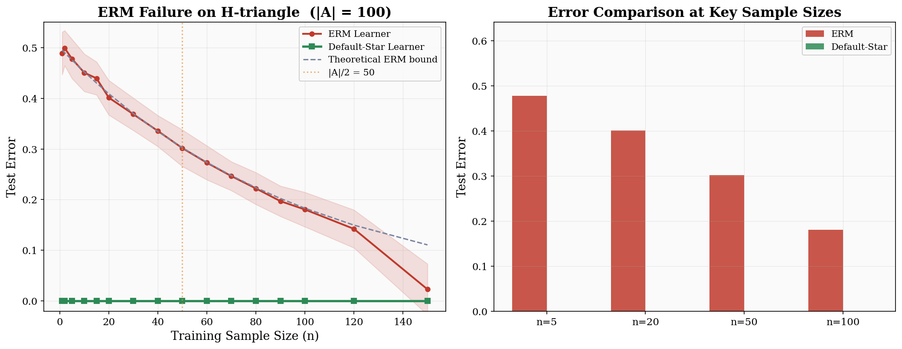
EXPERIMENT 1
ERM Failure on H-triangle

Slide 14
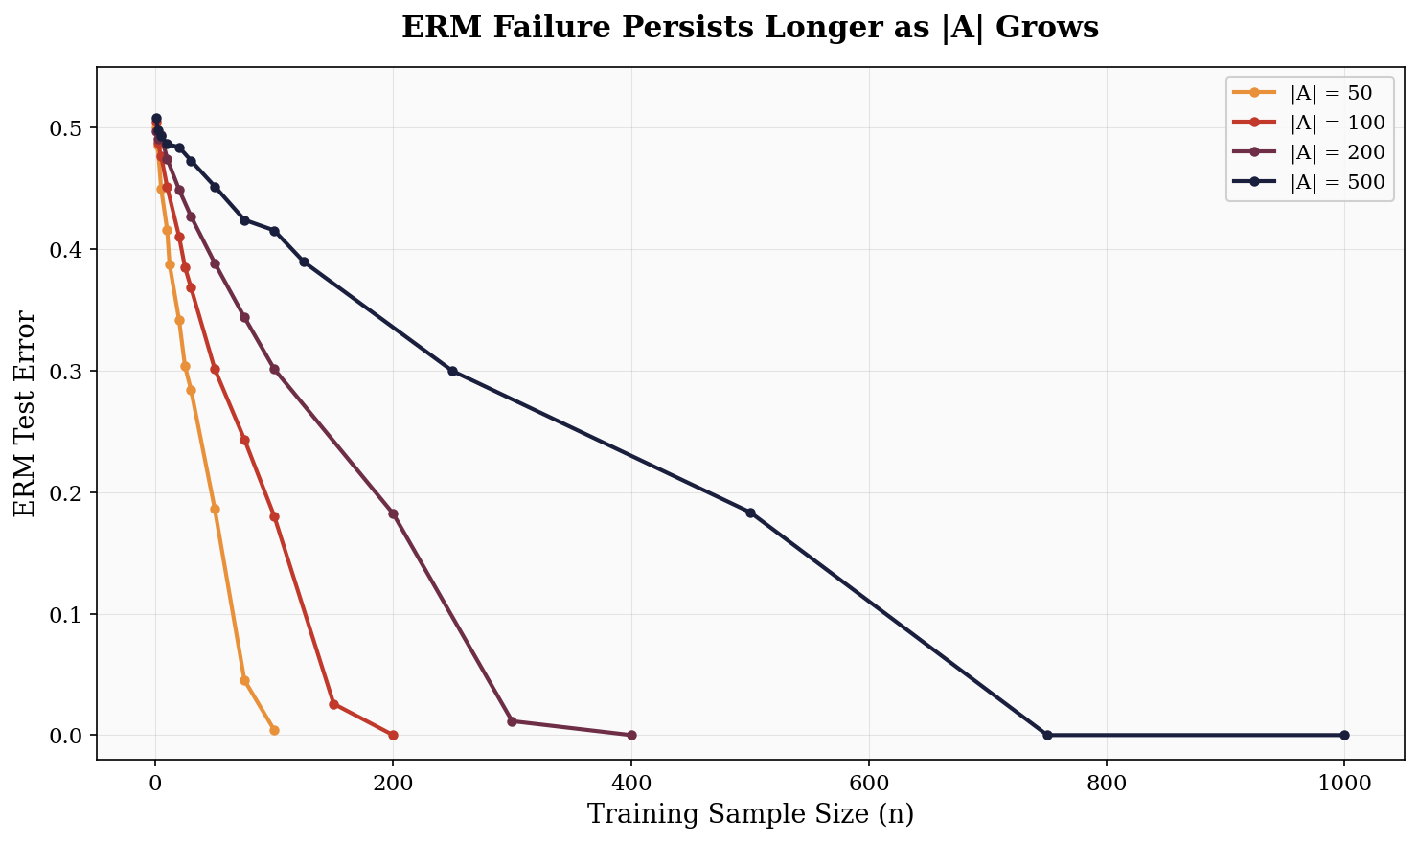
EXPERIMENT 2
ERM Failure Scales with |A|

Slide 15
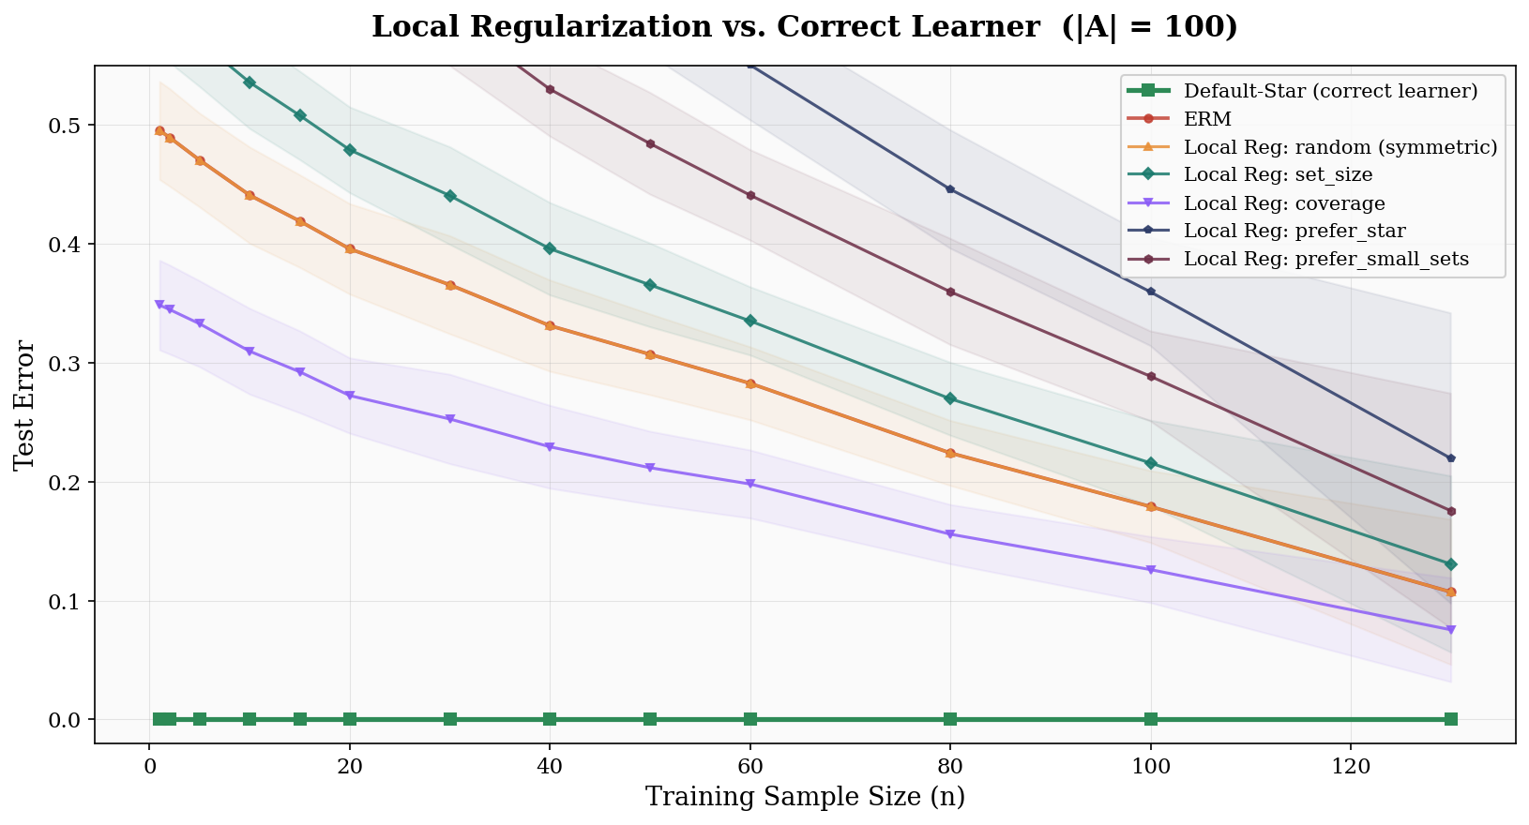
EXPERIMENT 3
Local Regularization Strategies All Fail

Slide 16
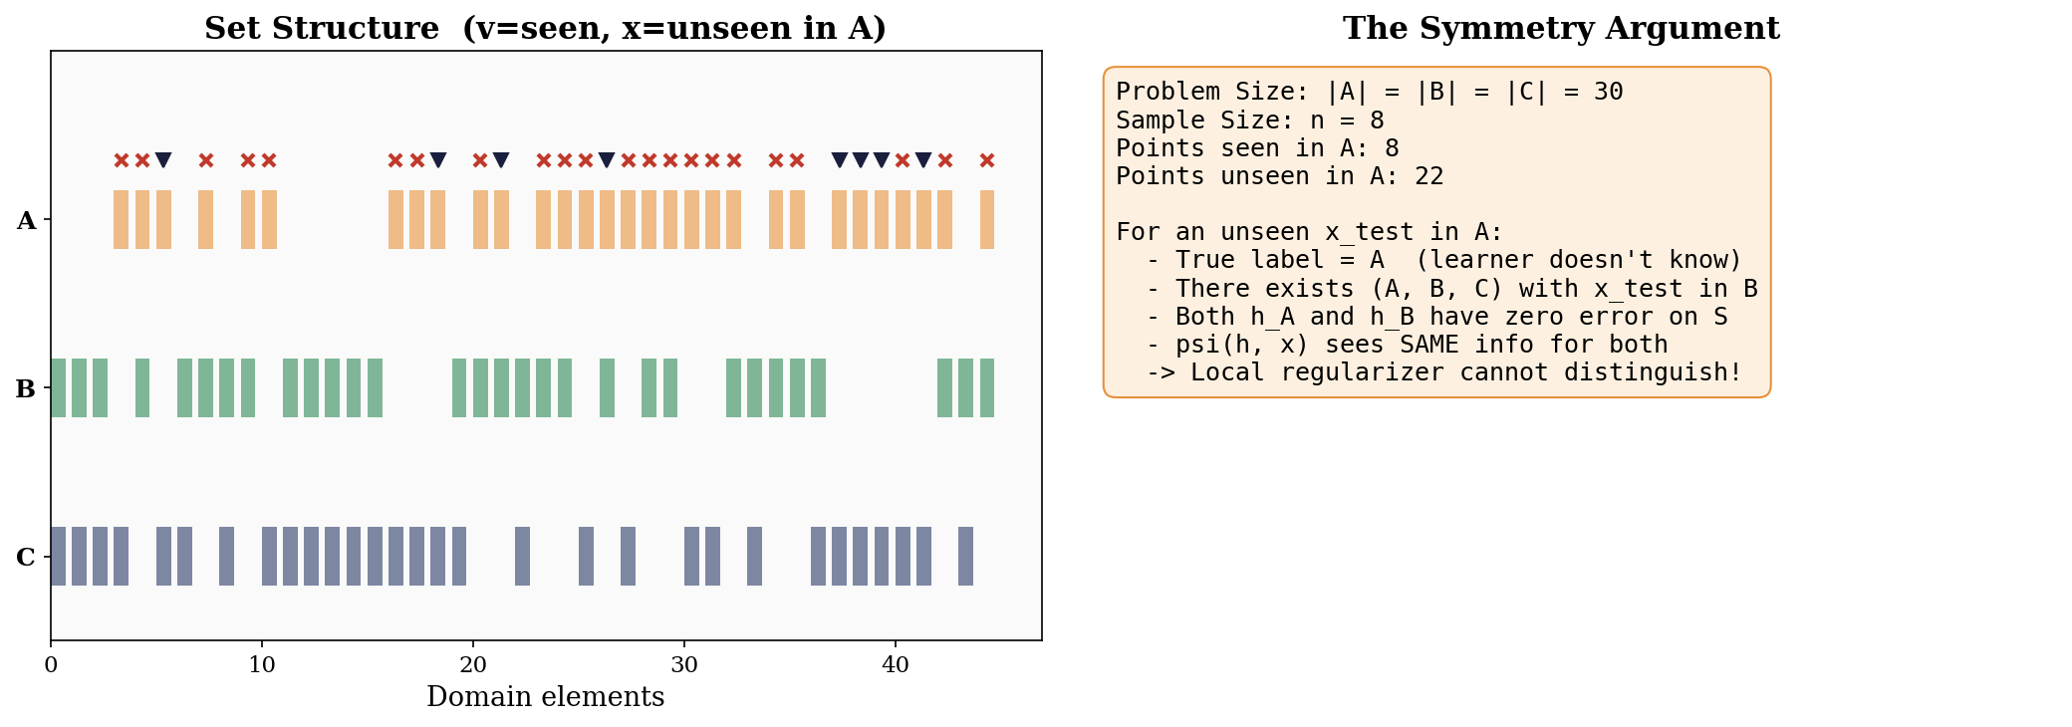
SYMMETRY ARGUMENT
Why Local Regularization Fails

Slide 17
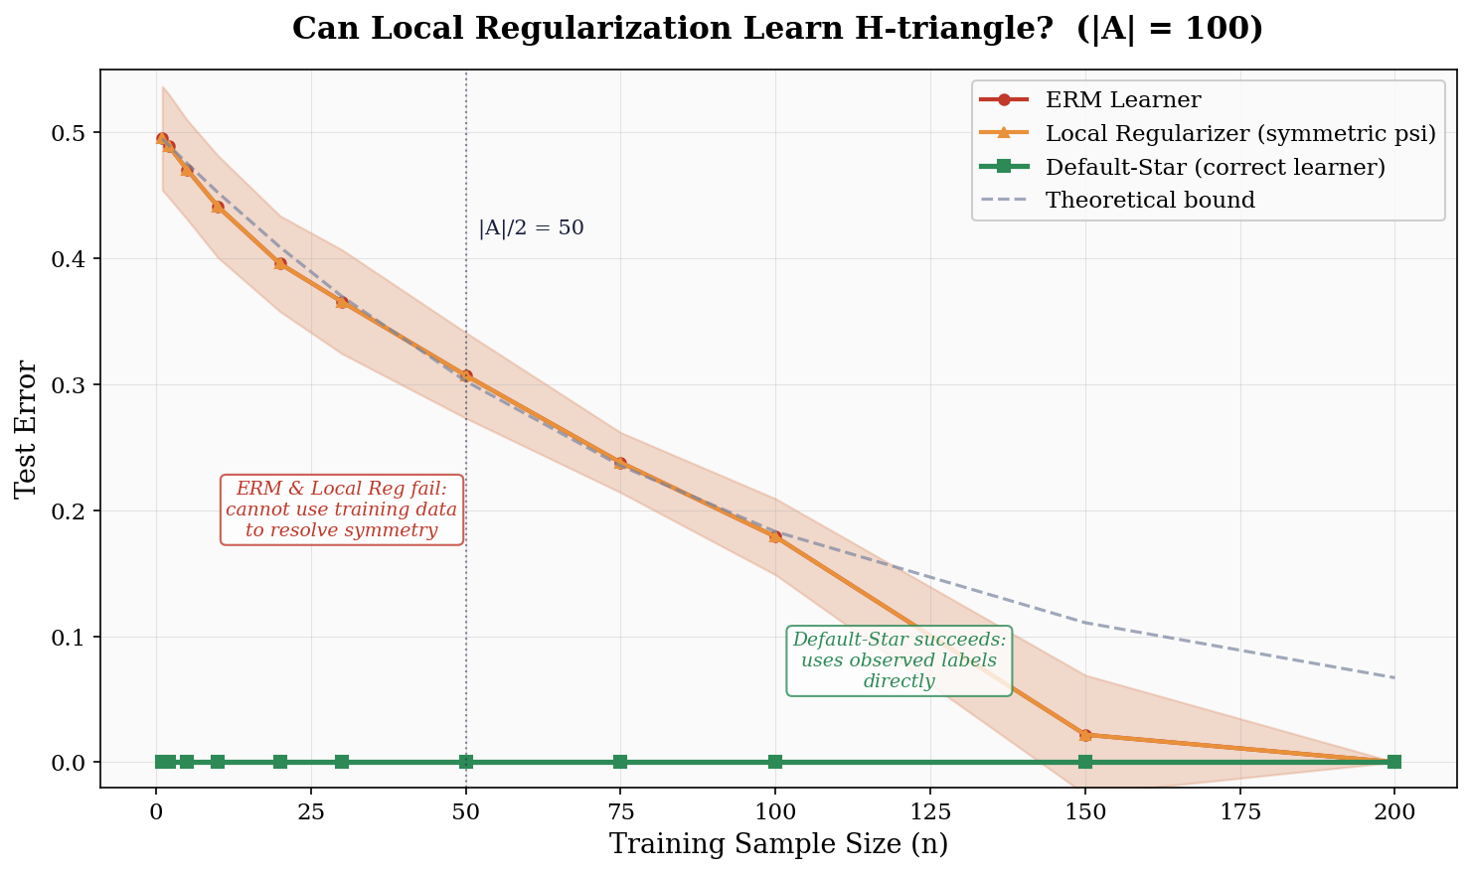
COMBINED RESULTS
Summary: Can Local Reg Learn H-triangle?

Slide 18
05 CONCLUSION
Significance of the Open Problems
If Positive
If Negative
Simple template for all multiclass learning
OIG structure is vital for learning
OIG unlabeled data is redundant
Training data geometry is essential
Simplifies classification theory
Fundamental limitation on regularization
Note: Unsupervised local regularization (with unlabeled data access) already works — the gap is surprisingly narrow.

Slide 19
05 CONCLUSION
Open Problems
Open Problem 1
In multiclass classification, can all learnable hypothesis classes be learned by a local regularizer? If so, with optimal (or nearly optimal) sample complexity?
Open Problem 2
Can the class H-triangle be learned by a local regularizer? If so, with optimal (or nearly optimal) sample complexity?

Slide 20
Thank You
Questions & Discussion
Asilis, Devic, Dughmi, Sharan, Teng | University of Southern California
{asilis, devic, shaddin, vsharan, shanghua}@usc.edu

